Slide 1
FUNCTIONAL NARRATIVE(SHOULD)
1.Customers can purchase clogs by visiting the Crocs store
2. When a customer visits the store to purchase the product, the cashier uses a Point of Salesystem to record the customer information and purchase details. The POS system is integrated with the CRM.
3. The ERP is integrated with the CRM.Therefore, the CRM system keeps a record of all customer transactions (including customer service requests , customer feedbacks about products etc)with the company.
4.The CRM and ERP(need ERP database to access cost and revenue information) databases act as sources for a data warehouse. The warehouse also contains a marketing database, with a record of conversion rates for previous marketing campaigns.The data warehouse is created by a Data Engineer.
Raw Data is collected from social media platforms and is stored in a Data Lake.The Data Lake is created by the data engineer.

Slide 2
5.Social media analysis on the big data is done to find their potential customer demographic and their preferences.(If a person is viewing sandals with straps for support on instagram then he might buy clogs, if straps are included).
6.The marketing analyst creates dashboards from this data to understand the existing customer buying patterns and demographic. Machine learning models are deployed by the ML engineer to predict if a customer will buy the product if new features are added( ex. If he buys product with a feature A then will he buy product with feature B?).
7. Additionally social media listening tools(These tools allow you to build an understanding of how customers and potential customers think about you by analyzing what they say on social channels.It can be integrated with the CRM). The marketing team can use these insights to:
-identify competitors and device strategies to gain competitive edge.
-identify the company’s brand image and potentially rebrand
8. The marketing data analyst communicates the gained insights from step 5, 6 and 7 to the product development team so that they can make design changes to the clogs in a way that they appeal to their existing as well as potential customers.
Deploying ML models for social media data allows machines to decide which advertisements are to be shown to which audience.

Slide 3
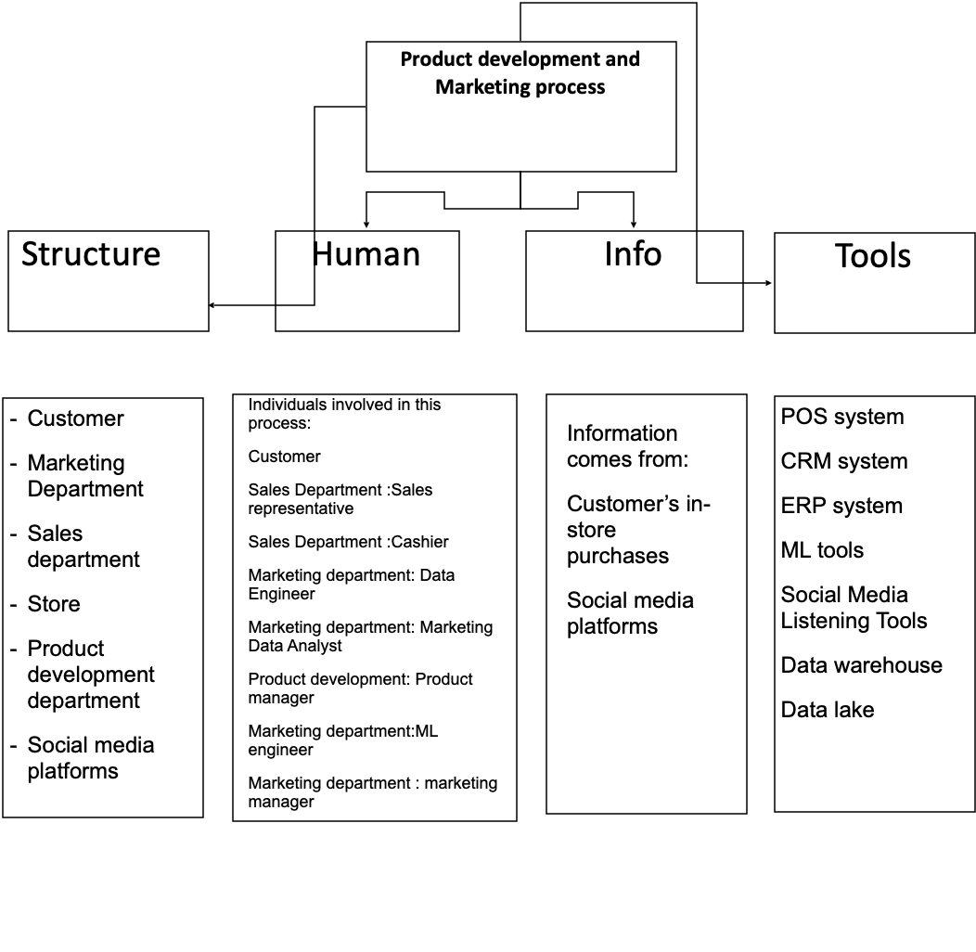
Product development and Marketing Process PROCESS Constituents (SHOULD)

Slide 4
PRODUCT DEVELOPMENT AND MARKETING RELATIONSHIP MAP (SHOULD)

Slide 5
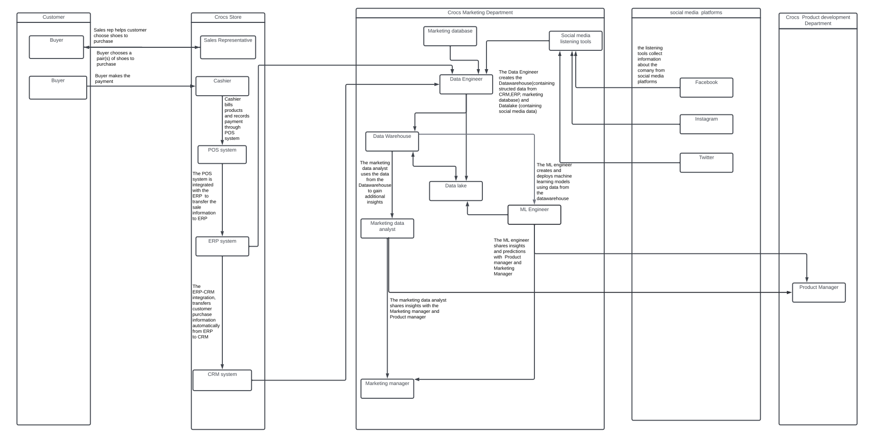

Slide 6
PRODUCT DEVELOPMENT AND MARKETING PROCESS MAP (SHOULD)

Slide 7
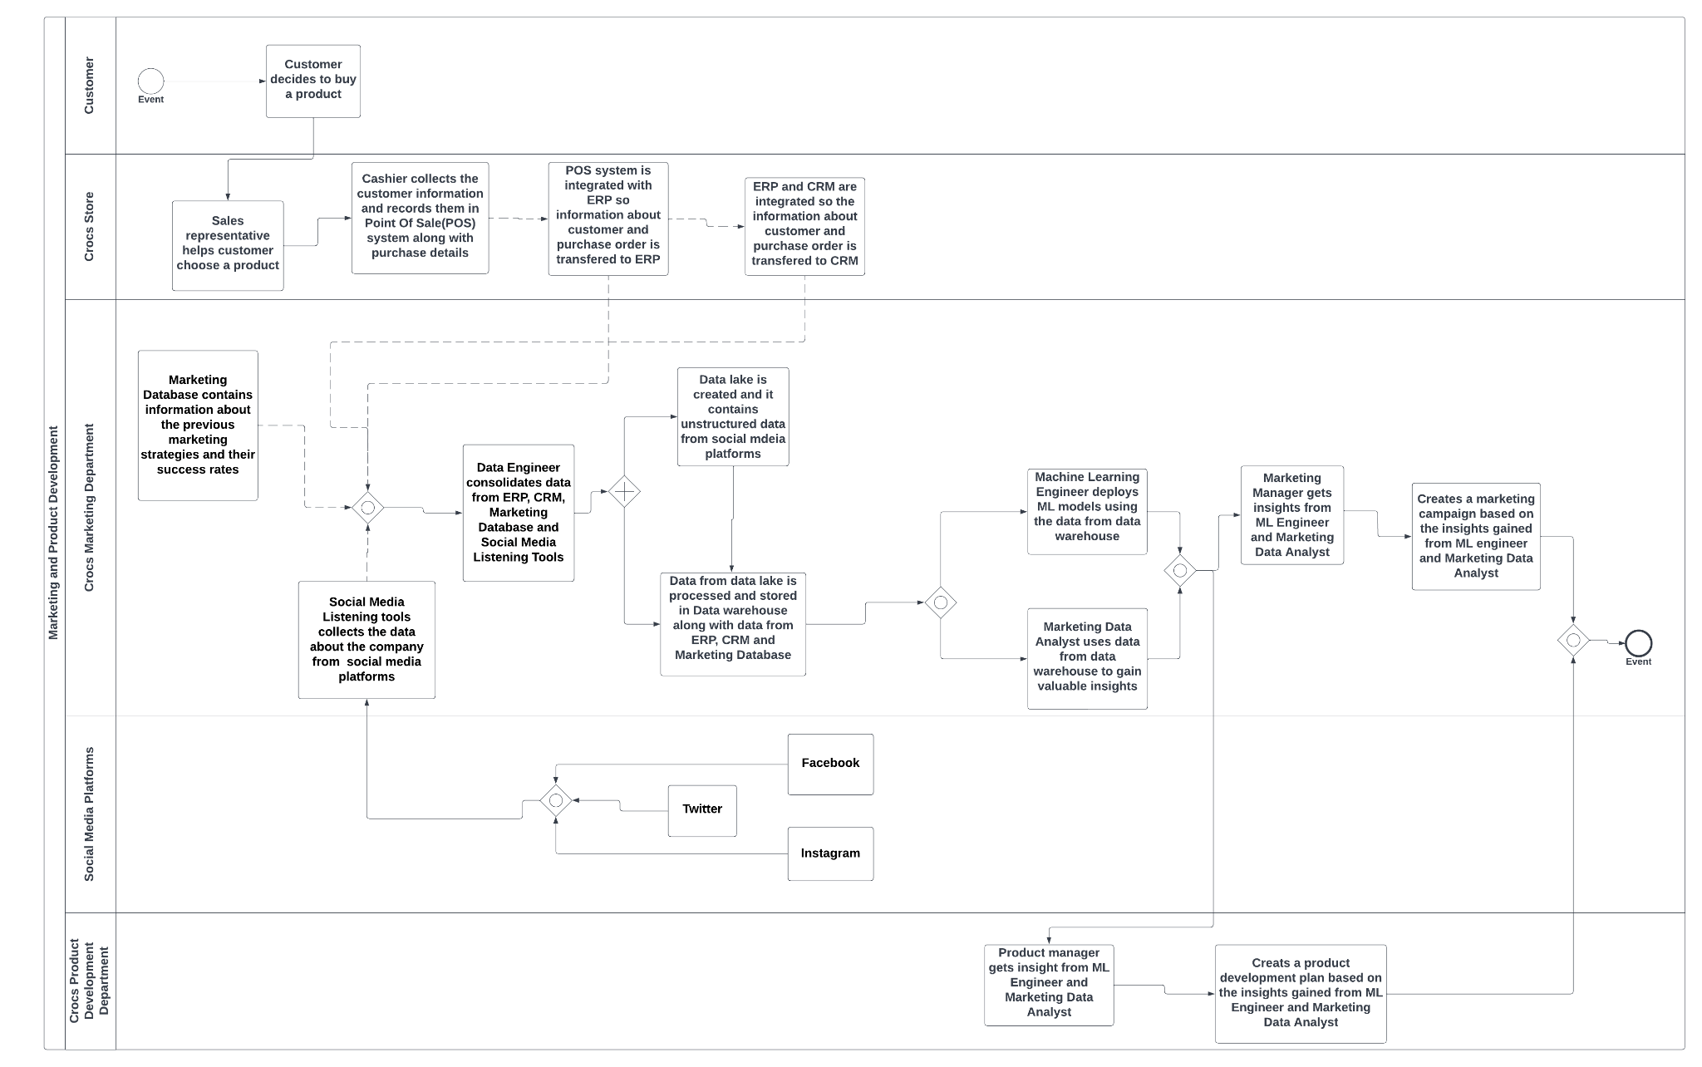

Slide 8
PROCESS MAP (SHOULD) WITH TASK SUB GOALS

Slide 9
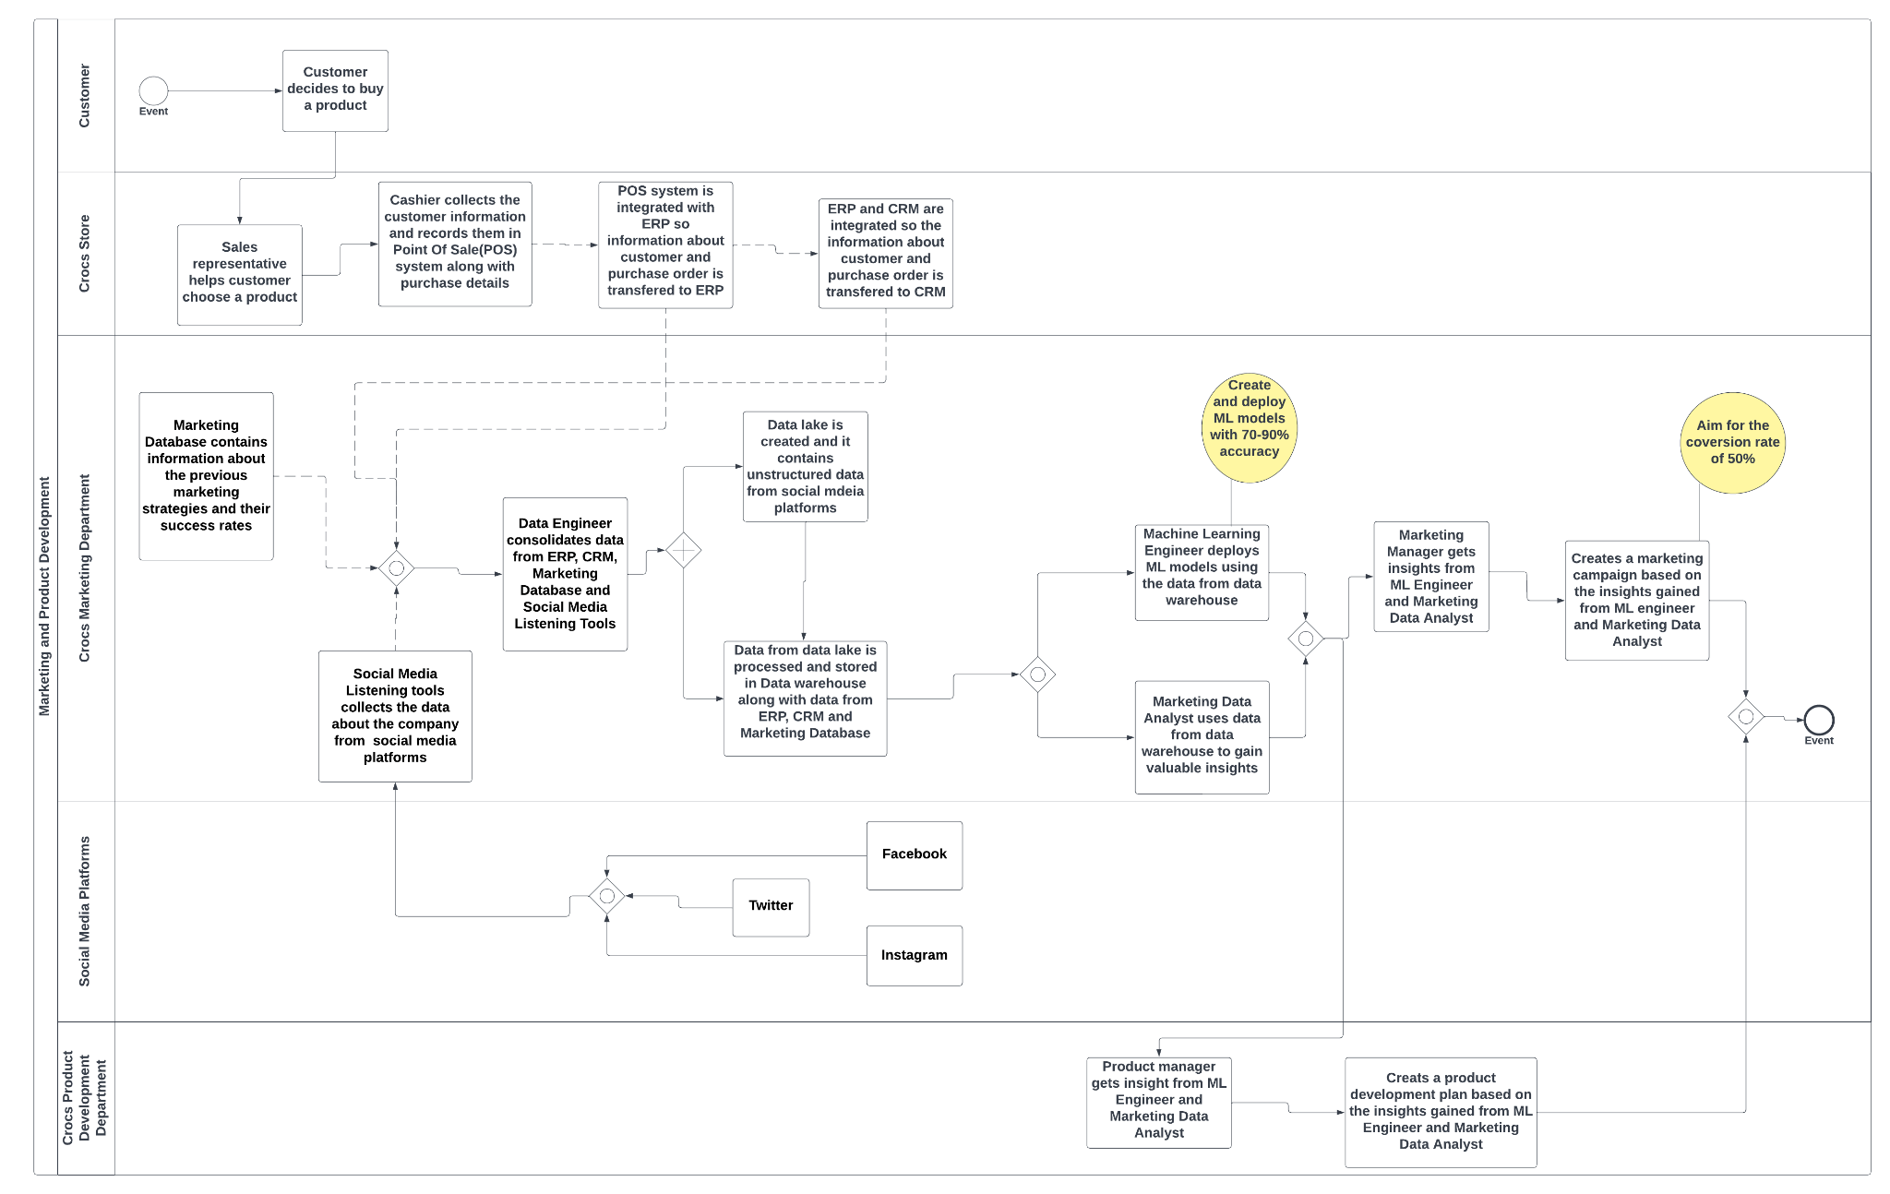

Slide 10
Product Development and Marketing Process : Organizational Goals
Use technology to understand the needs of current and potential customers of our signature product, clogs.
Use technology to understand to understand competitors.
Device sales, marketing, product strategies that help create a positive brand image and better market positioning of our products.
Hire the right talent to implement and make optimal use of the technologies.

Slide 11
Process Goals:
Use ERP and CRM systems to store and collect customer information and purchase details.
Use social media listening tools to build an understanding of how customers and potential customers think about the company by analyzing what they say on social channels.
Data Engineer should create and a Data Warehouse and a Data Lake( which contains ERP, CRM, marketing database and social media information, respectively)
Machine learning Engineer should create and deploy Machine Learning models to predict potential customer behavior and for targeted ads on social media.
Marketing Data Analyst should uncover trends and patterns across data in the data warehouse.
Marketing Manager should device a marketing strategy based on inputs from the marketing data analyst and ML engineer
Product manager should create a product development strategy based on inputs from the marketing data analyst and ML engineer
Operating Goals:
Create and Deploy Machine Learning models with 70-90% accuracy.
Aim for a conversion rate of 50%

